Slide 1

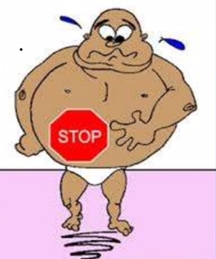

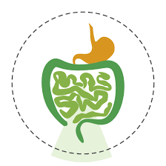

Lecture Title:Intestinal Obstruction
University of Basrah Al-zahraa college of medicine
Ministry of higher Education and Scientific Research
Block: Gastro-Intestinal Tract (GIT)
Induction phase
Lecture Duration: 2hrs
  Prof.Dr. Mazin H A l -Hawwaz
block Staff:
Dr. Wisam Hamza Dr. Haider Mohssen Dr. Thura Kadhim
Dr. Jawad Ramadhan Dr. Talal Hadi Dr. Haithem Hussein
Dr. Sadek Hassen Dr. Mustafa Ghazi Dr. Shuhdi Hussein
Dr. Nawaf Salah Aldeen
This Lecture was loaded in blackboard and you can find the material
Baily and Love’s Short Practice of Surgery, 25th edition, 2008
For more detailed instructions, any question, or you have a case you need help in, please post
to the group of session

Slide 2
University of Basrah Al-zahraa medical college
Ministry of higher Education and Scientific Research
Learning objectives:
To understand:
•• The causes of small and large bowel obstruction
•• The pathophysiology of dynamic and a dynamic intestinal obstruction
•• The cardinal features on history and examination
•• The indications for surgery and other treatment options in bowel obstruction

Slide 3
University of Basrah Al-zahraa medical college
Ministry of higher Education and Scientific Research
Definition
: ¬Failure of propulsion of intestinal contents (blockage that keeps food or liquid from passing through small or large intestine ) Due to either mechanical occlusion (dynamic ) or failure of peristalsis (a dynamic ).
Aetiology
Mechanical (Dynamic) Obstruction
Functional (adynamic)
in which there is no mechanical obstruction; peristalsis is absent(paralytic ileus) or inadequate (pseudo-obstruction).
in which peristalsis is working against a
mechanical obstruction. It may occur in an acute or a chronic form

Slide 4
University of Basrah Al-zahraa medical college
Ministry of higher Education and Scientific Research
Causes of intestinal obstruction
Dynamic ( partial or complete )
●● Intraluminal
Faecal impaction
Foreign bodies
Bezoars
Gallstones
●● Intramural
Stricture
Malignancy
Intussusception
Volvulus
●● Extramural
Bands/adhesions
Hernia
Adynamic
●● Paralytic ileus
●● Pseudo-obstruction

Slide 5
University of Basrah Al-zahraa medical college
Ministry of higher Education and Scientific Research
Acute Obstruction: - usually in small bowel lead to severe colicky central abdominal pain, vomiting , distention and constipation.
Chronic Obstruction ;- usually in large bowel lead to lower abdominal pain, constipation, distention and vomiting .
Acute on Chronic Obstruction:- start in large bowel then involve small bowel(present early by pain and constipation then vomiting and distention)
Simple Obstruction: No vascular involvement
Strangulated Obstruction: Vascular involvement
Closed Loop : both ends are obstructed (Volvulus)
Obstruction may be classified clinically into two types:
The nature of the presentation will also be influenced by whether the obstruction is:
A complete bowel obstruction has all the cardinal features..
incomplete bowel obstruction can present with more chronic symptoms in which the symptoms are intermittent. Incomplete obstruction is also referred as partial or subacute

Slide 6
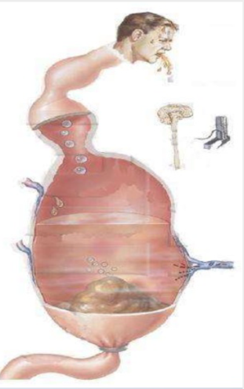
University of Basrah Al-zahraa medical college
Ministry of higher Education and Scientific Research
Pathophysiology
Above the Obstruction peristalsis increase bowel dilate reduction in peristalsis strength flaccid and paralysis
Below Obstruction normal peristalsis and absorption until it become empty it contracts and becomes immobile

Slide 7
University of Basrah Al-zahraa medical college
Ministry of higher Education and Scientific Research
PATHOPHYSIOLOGY
.Distention is caused by
1- gas
2- Fluids
●● Gas either swallowed (70%), diffused from blood (20%) or produced from putrefaction of food (10%).
..there is a significant overgrowth of both aerobic and anaerobic organisms, resulting in considerable gas production Following the reabsorption of oxygen and carbon
dioxide, the majority is made up of nitrogen (90%) and hydrogen sulphide
●● Fluid: this is made up of the various digestive juices and Swallowed fluid .
This accumulates
in the gut lumen as absorption by the obstructed gut is retarded.
¬500-1000 ml saliva
¬1000 - 1500 ml gastric juice
¬500-750 ml bile
¬500-1000 ml pancreatic secretion.
¬2000−3000 ml intestinal secretion
24 hours

Slide 8
University of Basrah Al-zahraa medical college
Ministry of higher Education and Scientific Research
Dehydration and electrolyte loss are due to:
●● reduced oral intake;
●● defective intestinal absorption;
●●Increased losses as a result 0f vomiting; sequestration in the bowel lumen;
●● transudation of fluid into the peritoneal cavity.
Systemic Effects of Obstruction
1- Water and electrolyte losses hypovolemia
2- Toxic materials sepsis
3-Cardiopulmonary dysfunction atelectasis
4- Renal failure
5- Shock death

Slide 9
University of Basrah Al-zahraa medical college
Ministry of higher Education and Scientific Research
STRANGULATION
When strangulation occurs, the blood supply is compromised and the bowel becomes ischemic
Firstly Venous return is compromised before the arterial supply increase congestion lead to free peritoneal fluid, edema of intestinal wall and blood in lumen.
once the arterial supply is impaired hemorrhagic infarction lead to ischaemia and gangrene or perforation As the viability of the bowel is compromised translocation and systemic exposure to anaerobic organisms and endotoxin occurs sepsis and shock
Causes of strangulation
Direct pressure on the bowel wall
●● Hernial orifices
●● Adhesions/bands
Interrupted mesenteric blood flow
●● Volvulus
●● Intussusception
Increased intraluminal pressure
●● Closed-loop obstruction

Slide 10
University of Basrah Al-zahraa medical college
Ministry of higher Education and Scientific Research
Closed-loop obstruction
the bowel is obstructed at both the proximal and distal points
Usually due to 1- Adhesions 2- Twist of mesentery 3-Volvulus 4- Internal hernia
The distension is principally confined to the closed loop;
distension proximal to the obstructed segment is not typically marked
A classic form of closed-loop obstruction is seen in the
presence of a malignant stricture of the colon with a competent
ileocecal valve (present in up to one-third of individuals).
The inability of the distended colon to decompress itself into
the small bowel results in an increase in luminal pressure,
which is greatest at the caecum, with subsequent impairment
of blood flow in the wall. Unrelieved, this results in necrosis
and perforation

Slide 11
University of Basrah Al-zahraa medical college
Ministry of higher Education and Scientific Research
DIAGNOSIS
HISTORY
CLINICAL EXAMINATION
INVESTIGATIONS

Slide 12
University of Basrah Al-zahraa medical college
Ministry of higher Education and Scientific Research
CLINICAL FEATURES OF INTESTINAL OBSTRUCTION
The clinical features vary according to:
●● the location of the obstruction;
●● the duration of the obstruction;
●● the underlying pathology;
●● the presence or absence of intestinal ischaemia.
Cardinal clinical features of acute obstruction
●● Abdominal pain
●●Vomiting
●●Distension
●● Absolute constipation
●● During examination Visible Perstalsis
OTHERS 1-fatigue 2- infrequent urination

Slide 13
University of Basrah Al-zahraa medical college
Ministry of higher Education and Scientific Research
Features of obstruction
●● In high small bowel obstruction, vomiting occurs early, is profuse and causes rapid dehydration. Distension is minimal with little evidence of dilated small bowel loops on abdominal radiography
●● In low small bowel obstruction, pain is predominant with central distension. Vomiting is delayed. Multiple dilated small bowel loops are seen on radiography
●● In large bowel obstruction, distension is early and pronounced. Pain is less severe and vomiting and dehydration are later features. The colon proximal to the obstruction is distended on abdominal radiography. The small bowel will be
dilated if the ileocecal valve is incompetent.

Slide 14
University of Basrah Al-zahraa medical college
Ministry of higher Education and Scientific Research
Late manifestations of intestinal obstruction that may be encountered include dehydration, oliguria, hypovolemia shock, pyrexia, septicemia, respiratory embarrassment and
peritonitis.
In all cases of suspected intestinal obstruction, the hernial orifices must be examined
Pain
Is the predominant symptom in intestinal obstruction,and depend on the site of obstruction

Slide 15
University of Basrah Al-zahraa medical college
Ministry of higher Education and Scientific Research
Vomiting
The more distal the obstruction, the longer the interval between the onset of symptoms and the appearance of nausea and vomiting.
Distension
In the small bowel the degree of distension is dependent on the site of the obstruction and is greater the more distal the lesion.
Constipation
This may be classified as absolute (i.e. neither feces nor flatus is passed) or relative (where only flatus is passed). The rule that absolute constipation is present in intestinal
obstruction does not apply in:
●● Richter’s hernia;
●● gallstone ileus;
●● mesenteric vascular occlusion;
●● functional obstruction associated with pelvic abscess;
●● all cases of partial obstruction (in which diarrhoea may
occur).

Slide 16
University of Basrah Al-zahraa medical college
Ministry of higher Education and Scientific Research
Presentation will be further influenced by whether the\obstruction is:
●● simple – in which the blood supply is intact;
●● strangulating/strangulated – in which there is interference
to blood flow.
Dehydration
Dehydration is seen most commonly in small bowel obstruction because of repeated vomiting and fluid sequestration.
Pyrexia
Pyrexia in the presence of obstruction is rare and may indicate:
●● the onset of ischaemia;
●● intestinal perforation;
●● inflammation or abscess associated with the obstructing disease.
Abdominal tenderness
Localized tenderness indicates impending or established ischaemia.
Bowel sounds
High-pitched bowel sounds are present in the vast majority of patients with early intestinal obstruction. Bowel sounds may be scanty or absent if the obstruction is longstanding and the small bowel has become inactive.

Slide 17
University of Basrah Al-zahraa medical college
Ministry of higher Education and Scientific Research
Clinical features of strangulation
Is a surgical emergency. The diagnosis is almost entirely clinical. Clinical features of strangulation
●● Constant pain, severe pain
●● Tenderness with rigidity and peritonism
●● Shock The presence of shock suggests underlying ischaemia, especially if the shock is resistant to simple fluid resuscitation.
●● In impending or established strangulation, pain is never completely absent.
●● The presence and character of any local tenderness are of great significance
●● Generalized tenderness and the presence of rigidity indicate the need for early laparotomy.
●● In cases of intestinal obstruction in which pain persists despite conservative management, even in the absence of the above signs, strangulation should be presumed.
●● When strangulation occurs in an external hernia, the lump is tense, tender and irreducible and there is no expansile cough impulse. Skin changes with erythema or purplish
discoloration are associated with underlying ischaemia

Slide 18
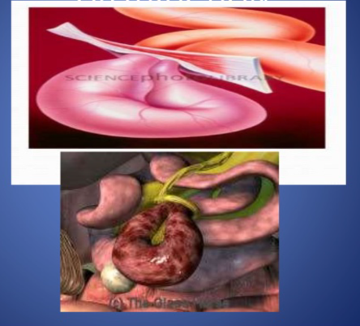
Strangulated Obstruction
University of Basrah Al-zahraa medical college
Ministry of higher Education and Scientific Research

Slide 19
University of Basrah Al-zahraa medical college
Ministry of higher Education and Scientific Research
INVESTIGATIONS
1-Blood
2- Radiological
BLOOD EXAMINATIOS
1-CBC
2-Urea and Electrolyte
3- Metabolic acidosis
4- Serum amylase

Slide 20
University of Basrah Al-zahraa medical college
Ministry of higher Education and Scientific Research
Radiological features of obstruction (on plain x-ray)
ERECT AND SUPINE
--- GAS- FLUID LEVEL IN ERECT
---- GASEOUS DISTENTION OF BOWEL IN SUPINE
●●ER●● The jejunum is characterized by its valvulae conniventes, which completely pass across the width of the bowel and are regularly spaced
●● Ileum – the distal ileum has been described by Wangensteen as featureless
●● Caecum – a distended caecum is shown by a rounded gas shadow in the right iliac fossa
●● Large bowel, except for the caecum, shows haustral folds, which, unlike valvulae conniventes, are spaced irregularly, do not cross the whole diameter of the bowel and do not have indentations placed opposite one another

Slide 21
University of Basrah Al-zahraa medical college
Ministry of higher Education and Scientific Research

Slide 22
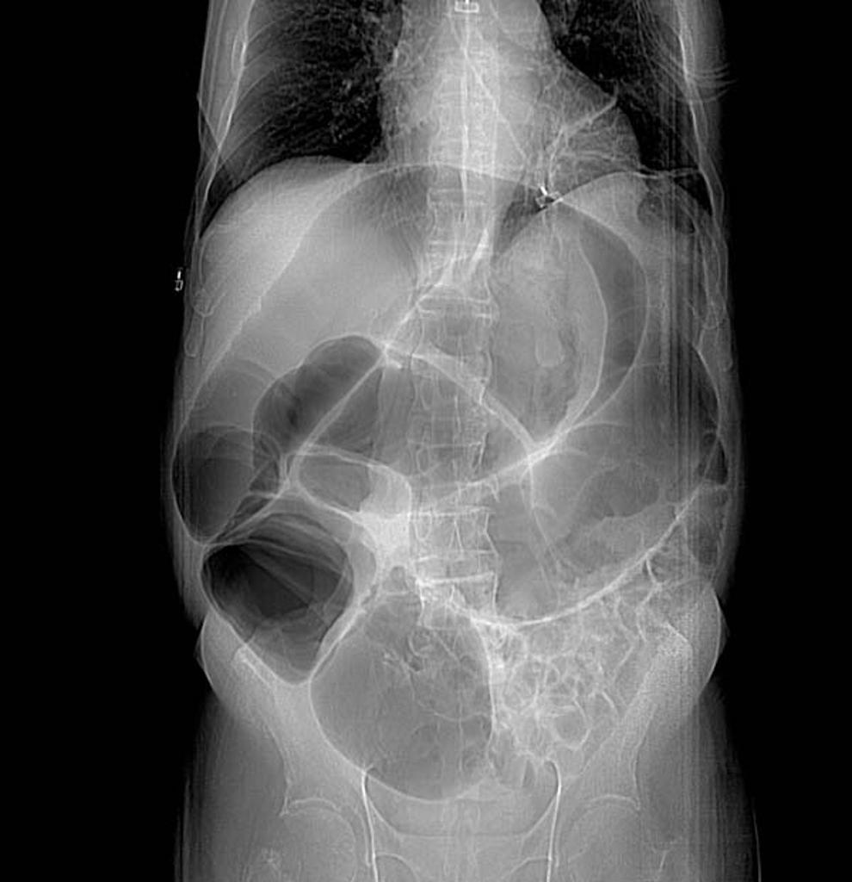
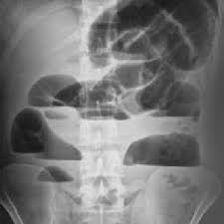
University of Basrah Al-zahraa medical college
Ministry of higher Education and Scientific Research

Slide 23
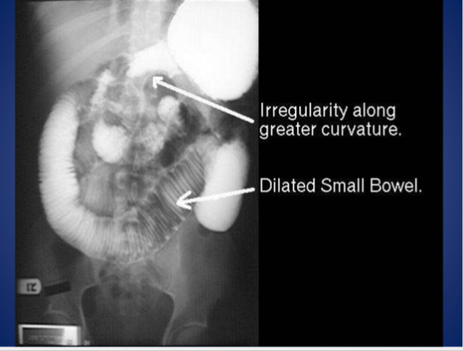
University of Basrah Al-zahraa medical college
Ministry of higher Education and Scientific Research

Slide 24
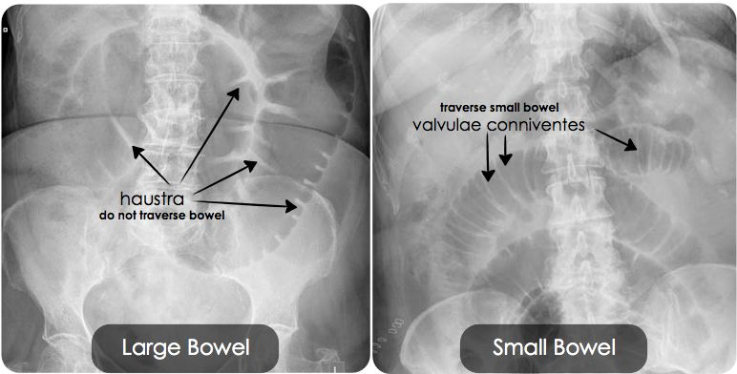
University of Basrah Al-zahraa medical college
Ministry of higher Education and Scientific Research

Slide 25
University of Basrah Al-zahraa medical college
Ministry of higher Education and Scientific Research
In intestinal obstruction, fluid levels appear later than gas shadows as it takes time for gas and fluid to separate .When fluid levels are pronounced, the obstruction
is advanced. In the small bowel, the number of fluid levels is directly proportional to the degree of obstruction and to its site, the number increasing the more distal the lesion.
Fluid levels may also be seen in non-obstructing conditions such as gastroenteritis, acute pancreatitis and intra-abdominal sepsis

Slide 26
University of Basrah Al-zahraa medical college
Ministry of higher Education and Scientific Research
The CT scan is now used very widely to investigate all forms of intestinal obstruction. It is highly accurate
1- Patients with abdominal malignancy
2- Post surgical patients
2- In diagnosing ischaemia. Two CT scan
findings may be used in clinical practice when looking for intestinal ischaemia: reduced enhanced bowel wall is highly predictive of ischaemia and absence of mesenteric fluid is a reliable finding to rule out strangulation.

Slide 27
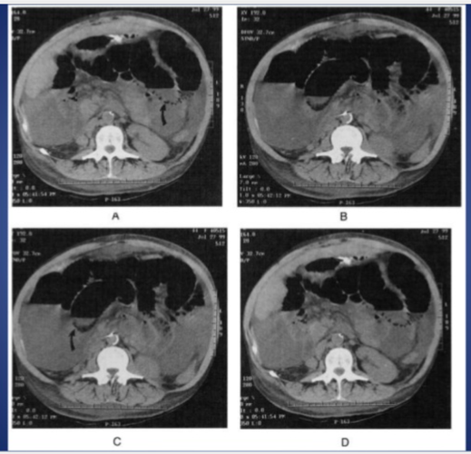
University of Basrah Al-zahraa medical college
Ministry of higher Education and Scientific Research

Slide 28
University of Basrah Al-zahraa medical college
Ministry of higher Education and Scientific Research
TREATMENT OF INTESTINAL OBSTRUCTION
DANGEROUS SIGNS
1- Constant pain
2-Absent bowel sounds
3- Tenderness with rigidity
4- Leukocytosis
5-Fever and tachycardia
6- Shock

Slide 29
University of Basrah Al-zahraa medical college
Ministry of higher Education and Scientific Research
Treatment of Acute Intestinal Obstruction
Supportive management
Nasogastric decompression as facilitating decompression proximal to the obstruction, they are essential to reduce the risk of subsequent aspiration during induction of anesthesia and post-extubation.
IV fluids
Urinary catheter
The basic biochemical abnormality in intestinal obstruction is sodium and water loss, and therefore the appropriate replacement is Hartmann’s solution or normal saline.
Antibiotics are not mandatory but many clinicians initiate broad-spectrum antibiotics early in therapy because of bacterial overgrowth. Antibiotic therapy is mandatory for all patients undergoing surgery for intestinal obstruction.
Monitored continuously every 2hrs.
Surgical treatment is necessary for most cases of intestinal obstruction but should be delayed until resuscitation is complete, provided there is no sign of strangulation or evidence of closed-loop obstruction

Slide 30
University of Basrah Al-zahraa medical college
Ministry of higher Education and Scientific Research
  Surgical treatment
Indications
1- Failure of conservative management
2- Irreducible hernia
3-Strangulation
The timing of surgical intervention is important and depend on the clinical picture.
Laparotomy assessment is directed to
1- The site of obstruction
2- the nature of obstruction
3- the viability of intestine

Slide 31
University of Basrah Al-zahraa medical college
Ministry of higher Education and Scientific Research
Indications of non-viability
1- Absent peristalsis
2- Loss of normal shine
3- Loss of pulsation in mesentry and mesenteric artery also
4- Green or black colour bowel

Slide 32
University of Basrah Al-zahraa medical college
Ministry of higher Education and Scientific Research
ADYNAMIC OBSTRUCTION
Paralytic ileus
Defined as a state in which there is failure of transmission of peristaltic waves secondary to neuromuscular failure (i.e. in the myenteric (Auerbach’s) and submucous (Meissner’s) plexuses). The resultant stasis leads to accumulation
of fluid and gas within the bowel, with associated distension, vomiting, absence of bowel sounds and absolute constipation
.Etiology
●● Postoperative: a degree of ileus usually occurs after any abdominal procedure and is self-limiting, with a variable duration of 24–72 hours.
●● Infection (peritonitis): intra-abdominal sepsis may give rise to localized or generalized ileus.
●● Reflex ileus: this may occur following fractures of the spine or ribs, retroperitoneal haemorrhage .
●● Metabolic (electrolyte imbalance: uraemia ? and hypokalemia are the most common contributory factors.
..Drugs
..Ischemia

Slide 33
University of Basrah Al-zahraa medical college
Ministry of higher Education and Scientific Research
Clinical features
1- Usually takes on 72 hours after laparotomy
2-No return of bowel sounds on auscultation
3- No passage of flatus.
4- Abdominal distension becomes more marked
5- Colicky pain is not a feature.
6- Radiologically, the abdomen shows gas-filled loops of intestine with multiple fluid level.
Management
●● If a primary cause is identified this must be treated.
●● Gastrointestinal distension must be relieved by decompression.
●● Close attention to fluid and electrolyte balance is essential.
●● There is no convincing evidence for the use of prokinetic drugs to treat postoperative adynamic ileus.
●● If paralytic ileus is prolonged CT scanning is the most effective investigation; it will demonstrate any intraabdominal sepsis or mechanical obstruction.
The need for a laparotomy becomes increasingly likely1- the longer the bowel inactivity
persists, particularly if it lasts for more than seven days 2- if bowel activity recommences following surgery and then stops again.

Slide 34
University of Basrah Al-zahraa medical college
Ministry of higher Education and Scientific Research
Ogilvie’s syndrome
Define as acute large bowel dilatation in the absence of mechanical obstruction usually in severely ill patients.
Abdominal radiographs shows huge dilatation of caecum and right colon
Indeed, caecal perforation is a well recognized complication.
Causes1- severely ill patient 2- uses od drugs e.g steroids ,narcotics and anticholinergic.
Diagnosis : 1- pain x-ray shows huge dilated colon 2- CT scan rule out mechanical obst.
Once confirmed, pseudo-obstruction requires
Treatment By 1- identifiable cause, If this is ineffective
2-Intravenous neostigmine(acetylcholinesterase inhibitors should be given (1 mg intravenously),
with a further 1 mg given intravenously within a few minutes if the first dose is ineffective.
, If neostigmine is not effective
3- colonoscope decompression should be performed.,
caecal perforation is more likely if the caecal diameter is 14 cm or greater.
4-Surgery is associated with high morbidity and mortality and should be reserved for those with impending perforation when other treatments have failed or perforation has occurred.
5-Rarely, an endoscopically placed tube colostomy is used as a vent for patients with a chronic unremitting condition

Slide 35
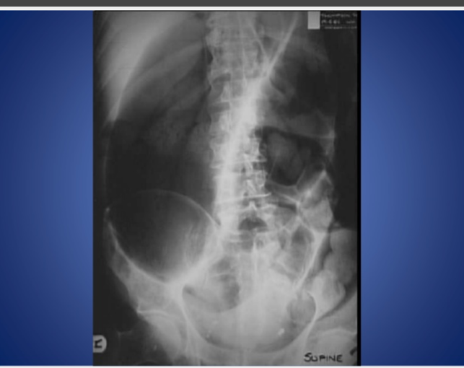
University of Basrah Al-zahraa medical college
Ministry of higher Education and Scientific Research

Slide 36



University of Basrah Al-zahraa medical college
Ministry of higher Education and Scientific Research

Slide 37
University of Basrah Al-zahraa medical college
Ministry of higher Education and Scientific Research
Obstruction by adhesions and bands
Adhesions
adhesions and bands are the most common cause of intestinal obstruction.
adhesional small bowel obstruction subsequent to abdominal surgery is around 4% and the risk of requiring a laparotomy around 2%.
In the early postoperative period, the onset of such a mechanical obstruction may be difficult to differentiate from paralytic ileus.

Slide 38
University of Basrah Al-zahraa medical college
Ministry of higher Education and Scientific Research
Prevention of adhesions
Factors that may limit adhesion formation include:
●● Good surgical technique
●● Washing of the peritoneal cavity with saline to remove clots
●● Minimizing contact with gauze
●● Covering anastomosis and raw peritoneal surfaces
Numerous substances have been instilled in the peritoneal
cavity to prevent adhesion formation, including hyaluronidase, hydrocortisone, silicone, dextran, polyvinylpropylene (PVP), chondroitin and streptomycin, anticoagulants, antihistamines, non-steroidal anti-inflammatory drugs and streptokinase.
Currently, no single agent or combination of agents has been convincingly shown to be effective.
widespread use of laparoscopic surgery the incidence of intra-abdominal adhesions will reduce

Slide 39
University of Basrah Al-zahraa medical college
Ministry of higher Education and Scientific Research
Adhesions may be classified into various types by virtue of whether they are early (fibrinous) or late (fibrous). From a practical perspective there are
only two types – ‘easy’ flimsy ones and ‘difficult’ dense ones.
Postoperative adhesions giving rise to intestinal obstruction usually involve the lower small bowel and almost never involve the large bowel.
Bands
Usually only one band is culpable. This may be:
●● congenital, e.g. obliterated vitellointestinal duct;
●● a string band following previous bacterial peritonitis;
●● a portion of greater omentum, usually adherent to the parietes.

Slide 40
University of Basrah Al-zahraa medical college
Ministry of higher Education and Scientific Research
Treatment of adhesive obstruction
●● Initially treat conservatively provided there are no signs of strangulation.
..should rarely continue conservative treatment for longer than 72 hours
●● At operation, divide only the causative adhesion(s) and limit dissection

Slide 41
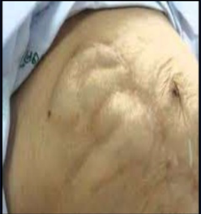
University of Basrah Al-zahraa medical college
Ministry of higher Education and Scientific Research
Thank you

Slide 42
University of Basrah Al-zahraa medical college
Ministry of higher Education and Scientific Research

Slide 43
University of Basrah Al-zahraa medical college
Ministry of higher Education and Scientific Research

